Slide 1
Tore Alden Principal Analyst The Jacobsen
Indonesian Palm Oil Export Ban
Notes:
Journey of transformation
Introductions to co presenters
Housekeeping & phones

Slide 2
On Friday, the Indonesian government announced a ban on edible oil exports. The government hopes the ban will help contain food inflation and follows a 40 percent surge in cooking oil prices so far this year.
The government has also set a cap of 14,000 rupiah per liter for bulk cooking oil sales. However, there have been reports of sales at 18,000 rupiah in April.
Fastmarkets | Agricultural Forecasting

Slide 3
By far, the largest destination for Indonesian palm oil is Asia, which includes China and India, two of the world’s largest vegetable oil importing countries.
The Jacobsen expects the ban to increase opportunities for soybean oil exports to Western Hemisphere countries, but it is unclear where the vegetable oil will come from to replace the decrease in Asian shipments.
Fastmarkets | Agricultural Forecasting

Slide 4
An increase in Malaysian shipments may offset a portion of the decrease in Indonesian shipments. However, The Jacobsen cut its forecast of Malaysian imports by 550,000 tonnes, limiting exportable supplies.
Despite the cut to The Jacobsen’s Indonesian palm oil export forecast, and the limited ability of Malaysian exports to fill the gap, it still expects shipments close to or above the five-year average.
Fastmarkets | Agricultural Forecasting

Slide 5
The Jacobsen predicts Indonesian shipments to the Western Hemisphere will decline by about 300 million pounds relative to the five-year average.
Due to limited exportable supplies, The Jacobsen only added 150 million pounds to its U.S. soybean oil export forecast due to the Indonesian ban.
Fastmarkets | Agricultural Forecasting

Slide 6
The ban comes as Indonesian production ramps up seasonally.
The Jacobsen predicts 2021/22 Indonesian palm oil production at 53.8 million tonnes, up 1.8 million from 52 million last year.
Unless month-over-month increases in production fall well below prior year’s the increase in output combined with the export ban should flood the Indonesian market with palm oil.
Fastmarkets | Agricultural Forecasting

Slide 7
Based on The Jacobsen’s adjustment to Indonesian exports, its forecast for 2021/22 Indonesian domestic use rises to 36.4 million tonnes from 26.4 million last year.
Indonesia’s President Widodo indicated he would monitor the situation and would lift the ban if the availability of cooking oil becomes abundant and affordable.
Fastmarkets | Agricultural Forecasting

Slide 8
In the longer term, falling yields due to ageing trees could cut into production, potentially cutting exportable supply in 2023/24.
Based on The Jacobsen’s outlook for production, it believes growth in biofuel feedstock demand will remain close to current volumes and may decline modestly in the coming years.
The forecast suggests modest weakness in prices next year before new records in 2023/24.
Fastmarkets | Agricultural Forecasting

Slide 9
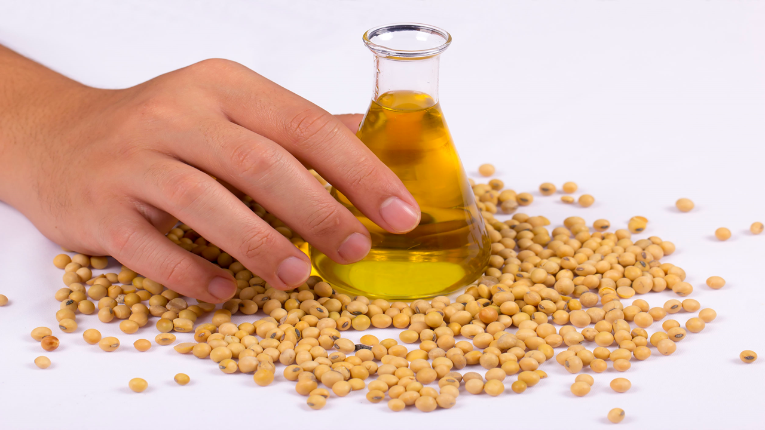

Questions?
Fastmarkets | Agricultural Forecasting

